Slide 1
Confidence Intervals for Differences between Population Parameters
Confidence Intervals (Continued…..)

Slide 2
CI for the Difference in Population Proportion
Is the population proportion of females with heart disease the same as the population proportion of males with heart disease?
If they are the same, then the difference in both the population proportions will be zero.
We will calculate a confidence interval of the difference in the population proportion of females and males with heart disease.
Here is the step by step process:
Calculate the male population proportion with heart disease and standard error using the same procedure.

Slide 3
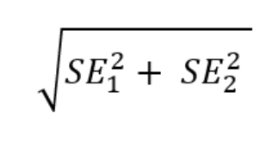
p_male = 114/(114+92) #male population proportion
n = 114+92 #total male population
The male population proportion with heart disease is 0.55 and the male population size is 206.
Calculate the standard error for the male population proportion.
se_male = np.sqrt(p_male * (1 - p_male) / n)
The standard error for the male population is 0.034.
Calculate the difference in standard error.
Here is the formula to calculate the difference in two standard errors:

Slide 4
Let’s use this formula to calculate the difference in the standard error of male and female population with heart disease.
se_diff = np.sqrt(se_female**2 + se_male**2)
Use this standard error to calculate the difference in the population proportion of males and females with heart disease and construct the CI of the difference.
d = 0.55 - 0.26 lcb = d - 1.96 * se_diff #lower limit of the CI ucb = d + 1.96 * se_diff #upper limit of the CI

Slide 5
The CI is 0.18 and 0.4.
This range does not have 0 in it. Both the numbers are above zero.
So, We cannot make any conclusion that the population proportion of females with heart disease is the same as the population proportion of males with heart disease.
If the CI would be -0.12 and 0.1, we could say that the male and female population proportion with heart disease is the same.
Calculation of CI of mean:
We will use the same heart disease dataset.
The dataset has a ‘chol’ column that contains the cholesterol level.

Slide 6
For this demonstration,
we will calculate the confidence interval of the mean cholesterol level of the female population.
Let’s find the mean, standard deviation, and population size for the female population.
I want to get the same parameters for the male population as well.
Because it will be useful for our next exercise.
Use pandas groupby and aggregate methods for this purpose.

Slide 7
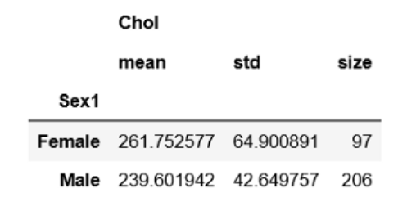
Here is the code to get the mean, standard deviation, and population size of the male and female population:
df.groupby("Sex1").agg({"Chol": [np.mean, np.std, np.size]})

Slide 8
If we extract the necessary parameters for the female population only:
mean_fe = 261.75 #mean cholesterol of female sd = 64.9 #standard deviation for female population n = 97 #Total number of female z = 1.96 #z-score from the z table mentioned before
Here 1.96 is the z-score for a 95% confidence level.
Calculate the standard error using the formula for the standard error of the mean
se = sd /np.sqrt(n)

Slide 9
Now we have everything to construct a CI for mean cholesterol in the female population:
Construct the CI:
lcb = mean_fe - z* se #lower limit of the CI ucb = mean_fe + z* se #upper limit of the CI (lcb, ucb)
The CI came out to be 248.83 and 274.67.
That means the true mean of the cholesterol of the female population will fall between 248.83 and 274.67

Slide 10
Calculation of CI of The Difference in Mean
There are two approaches to calculate the CI for the difference in the mean of two populations.
Pooled approach and
unpooled approach
As mentioned earlier, we need a simple random sample and a normal distribution.
If the sample is large, a normal distribution is not necessary.
There is one more assumption for a pooled approach.
That is, the variance of the two populations is the same or almost the same.

Slide 11
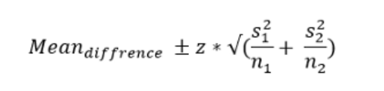
If the variance is not the same, the unpooled approach is more appropriate.
The formula of the standard error for the pooled approach is:
Here, s1 and s2 are the standard error for the population1 and population2.
In the same way, n1 and n2 are the population size of population1 and population2.

Slide 12
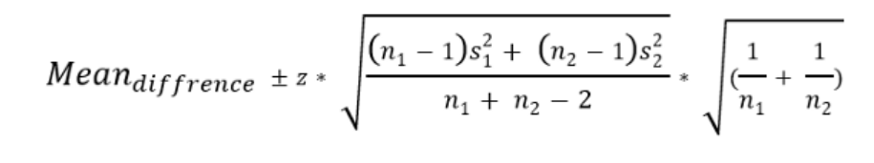
The formula of the standard error for the unpooled approach is:
Here, we will construct the CI for the difference in mean of the cholesterol level of the male and female population.
We already derived all the necessary parameters from the dataset in the previous example. Here they are:

Slide 13
n1 = 97 n2 = 206 mean_female = 261.75 mean_male = 239.6 sd_female = 64.9 sd_male = 42.65
As we can see, the standard deviation of the two target populations is different.
So. the variance must be different as well.
So, for this example, the unpooled approach will be more appropriate.

Slide 14
Calculate the standard error for male and female population using the formula we used in the previous example
sem_female = sd_female / np.sqrt(97) sem_male = sd_male / np.sqrt(206)
The difference in mean of the two samples:
mean_d = mean_female - mean_male
The difference in mean ‘mean_d’ is 22.15.
Using the formula for the unpooled approach, calculate the difference in standard error:
sem_d = (np.sqrt((n1-1)*se_female**2 + (n2-1)*se_male**2)/(n1+n2-2))*(np.sqrt(1/n1 + 1/n2))

Slide 15
Finally, construct the CI for the difference in mean
lcb = mean_d - 1.96*sem_d #lower limit of the CI ucb = mean_d + 1.96*sem_d #upper limit of the CI (lcb, ucb)
The lower and upper limit of the confidence interval came out to be 22.1494 and 22.15.
They are almost the same.
That means the mean cholesterol of the female population is not different than the mean cholesterol of the male population.

